Slide 1
Tratamento dos Hemangiomas da Infância
Francisco Helder C. Felix
Serviço de Onco-hematologia Pediátrica
Hospital Infantil Albert Sabin
SOHPHIAS

Slide 2
Hemangiomas da Infância
Tumores mais comuns da infância
3-10% das crianças caucasianas
Sexo feminino 2,4:1,0
Cor branca, não latinos
Prematuros (< 37 sem) e PMT extremos (<32 sem)
PIG
Idade materna > 30 anos, história familiar
Placenta prévia, pré-eclâmpsia
Adaptado de Haggstrom, 2007

Slide 3
Hemangiomas complicados
Maioria dos casos sem complicações
Regressão espontânea
Hemangiomas pequenos: até 3 anos
Cerca de 24% complicados
Próximo de 38% necessitaram tratamento
Tamanho grande
Localização facial (41% nesta série)
Hemangiomas segmentares X localizados
Desfiguração, cicatrizes
Adaptado de Haggstrom, 2006

Slide 4
Complicações
Ulceração: mais comum (16%)
Oclusão visual (5,6%)
Obstrução respiratória (1,4%)
Obstrução de canal auditivo (0,6%)
Comprometimento cardíaco (0,4%)
Adaptado de Haggstrom, 2007

Slide 5
Tratamento dos Hemangiomas
Corticosteróides sistêmicos (12,3%)
Corticosteróides intralesionais (4,1%)
Corticosteróides tópicos (9,8%)
Cuidados locais com ulcerações (13,7%)
Antibióticos orais (2,0%)
Dye laser pulsado (8,0%)
Excisão cirúrgica (5,7%)
Raramente: interferon e vincristina

Slide 6
Uso de propranolol
Léauté-Labrèze et al., NEJM, 2008

Slide 7
Léauté-Labrèze, 2008

Slide 8
Resultados do SOHPHIAS
Tratamento Não Padronizado (“Off-label”) de Pacientes Pediátricos Portadores de Hemangiomas com Propranolol no Hospital Infantil Albert Sabin entre janeiro e julho de 2009
O tratamento foi realizado após consentimento informado dos pais ou representantes legais dos pacientes e todas as fotos
foram mostradas após autorização dos mesmos

Slide 9
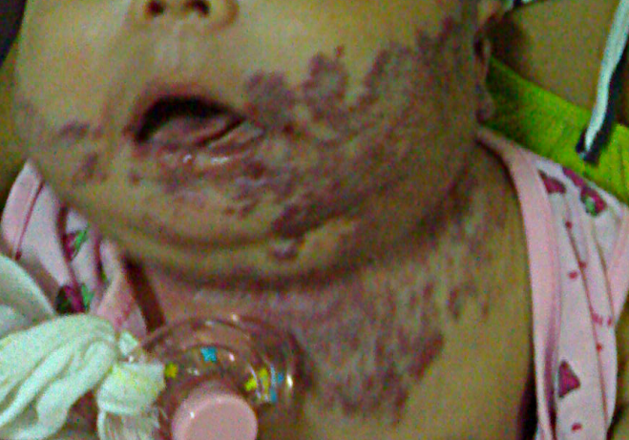
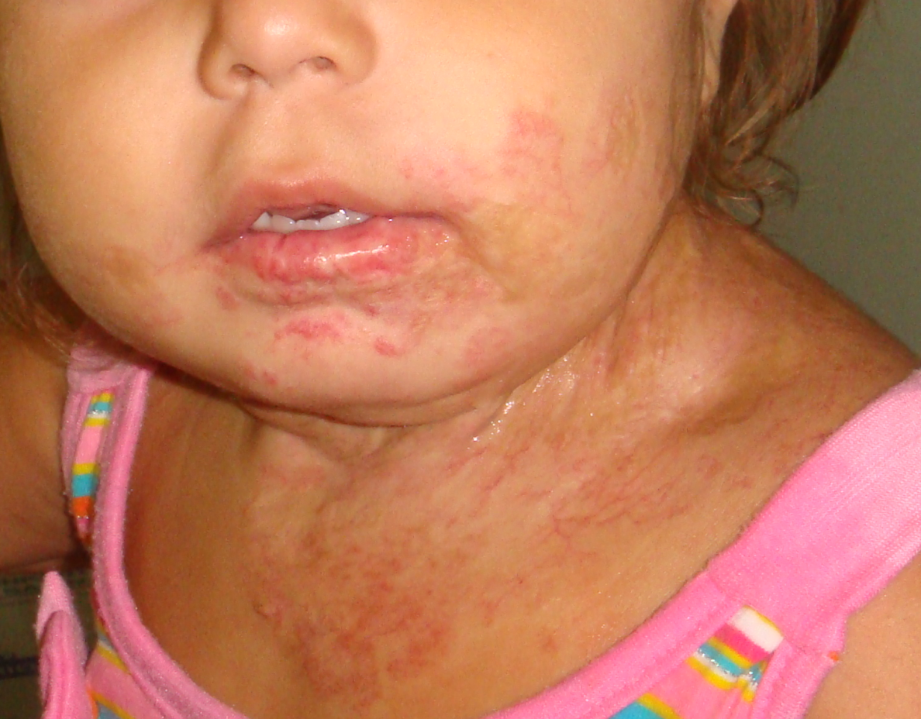
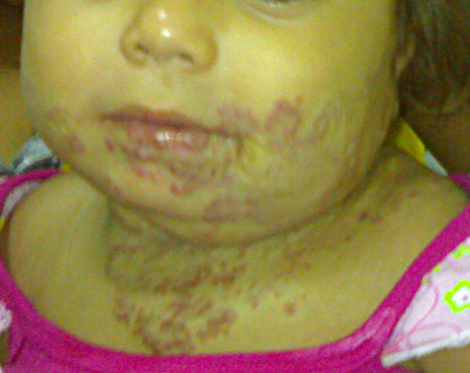

Slide 10
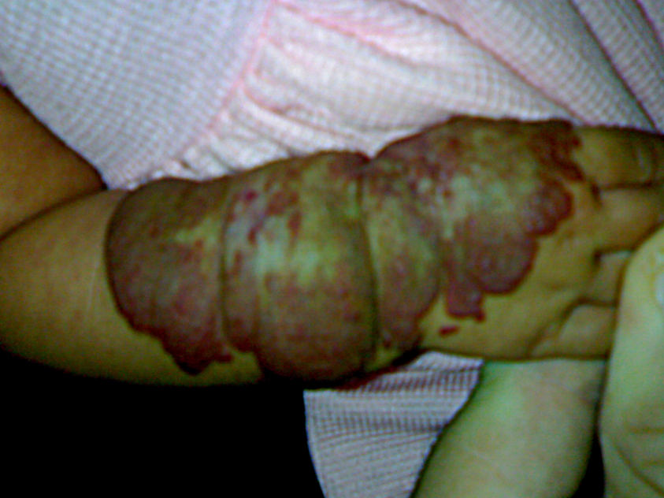
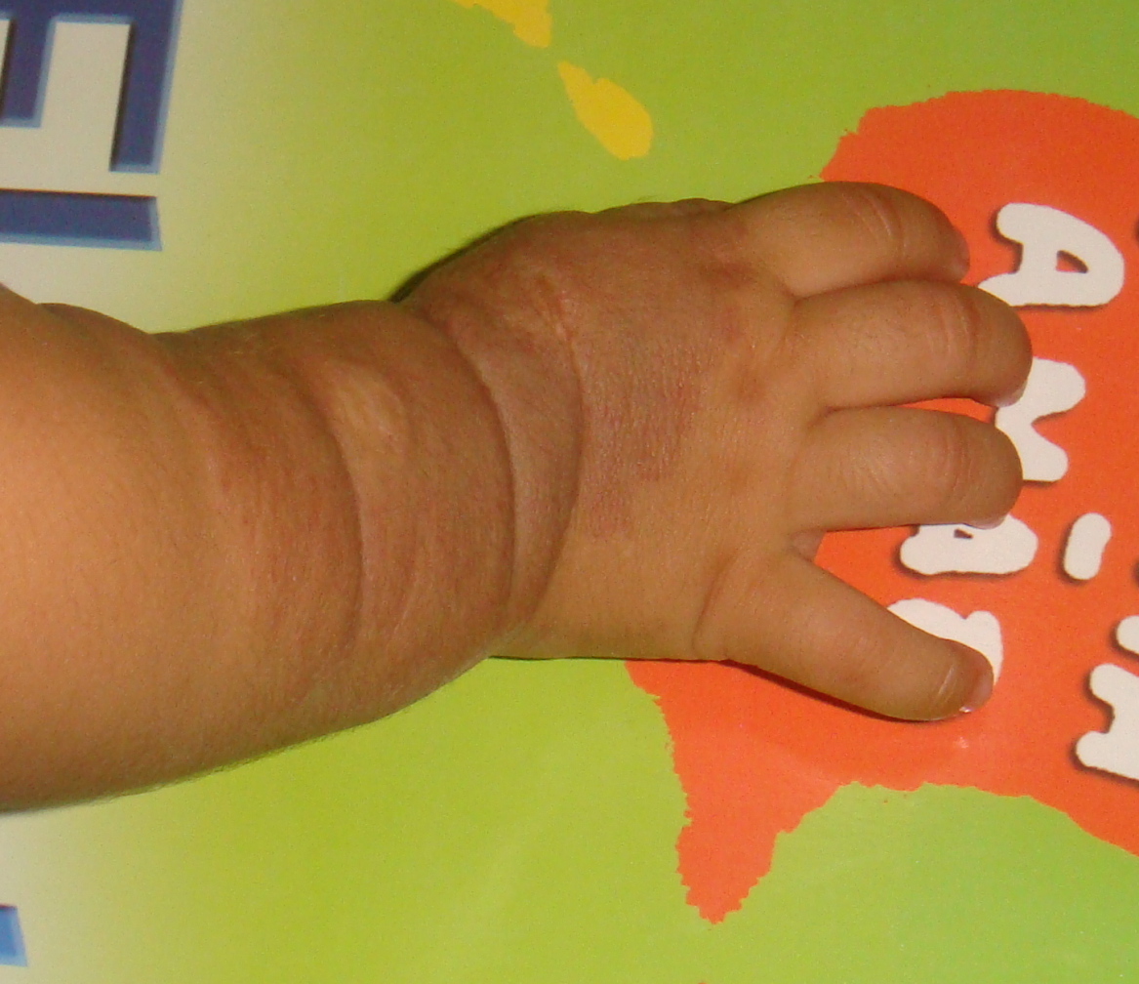
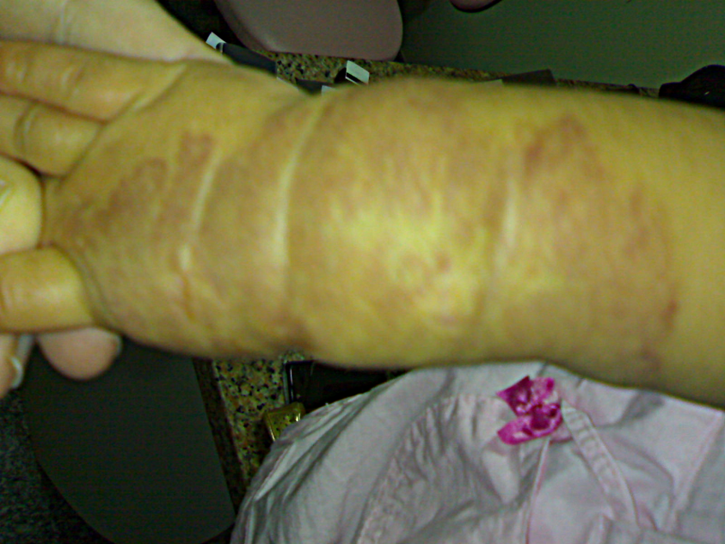

Slide 11
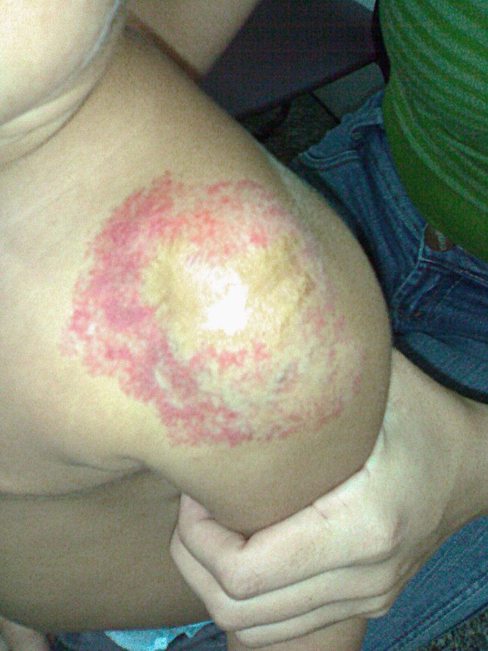
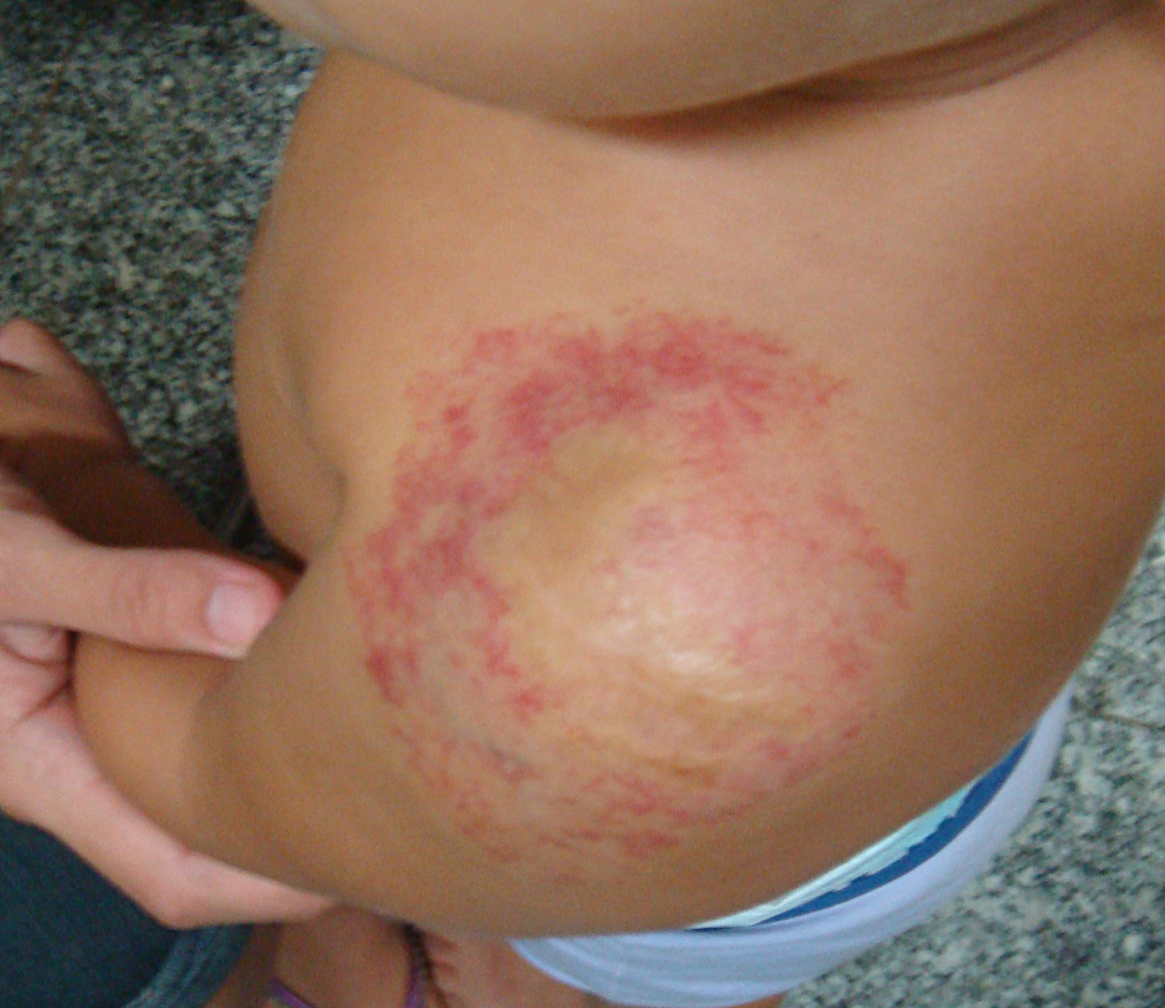

Slide 12
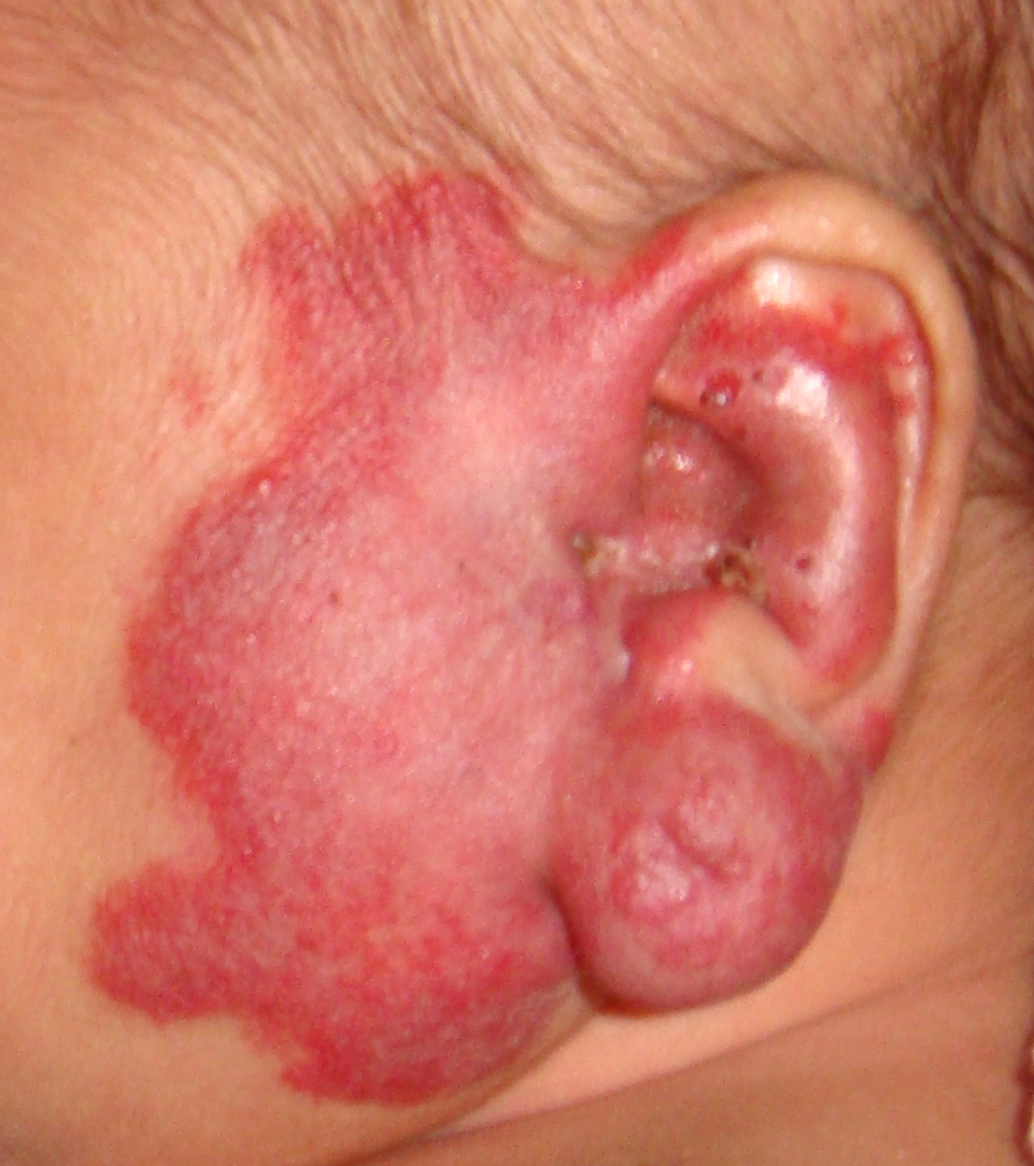
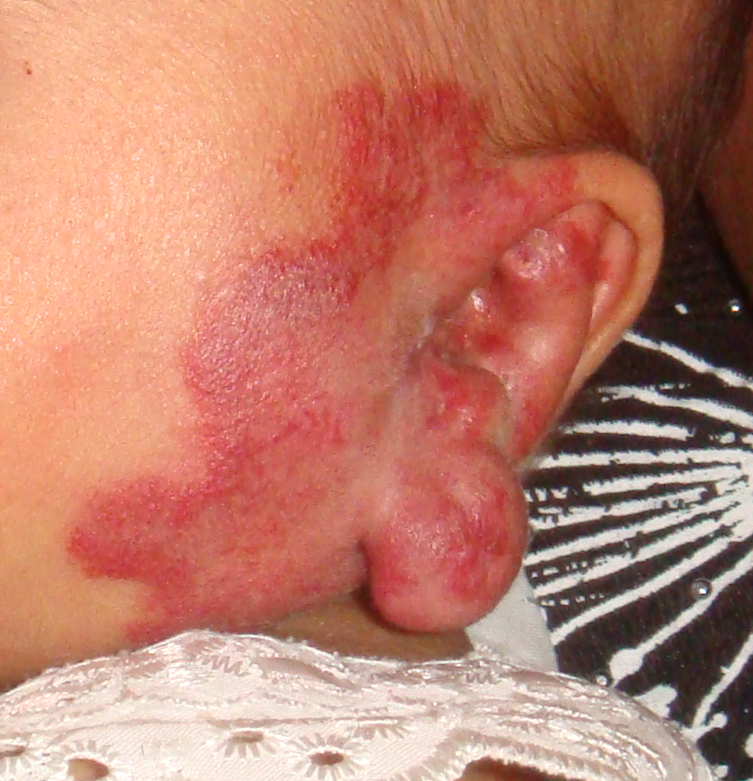

Slide 13


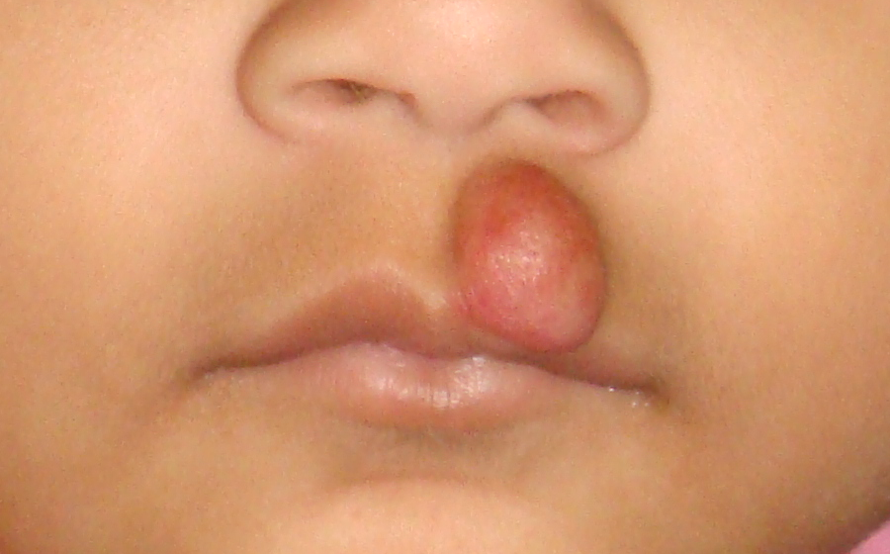

Slide 14
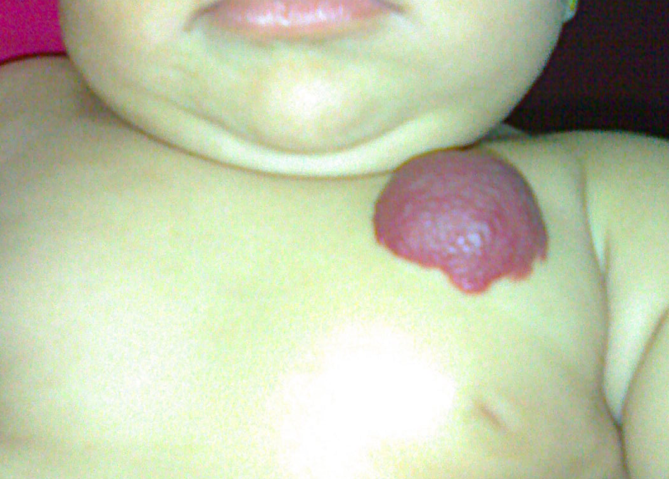
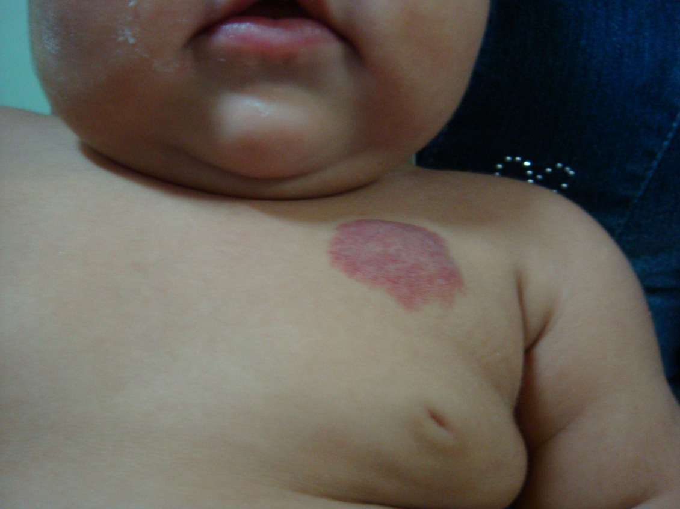
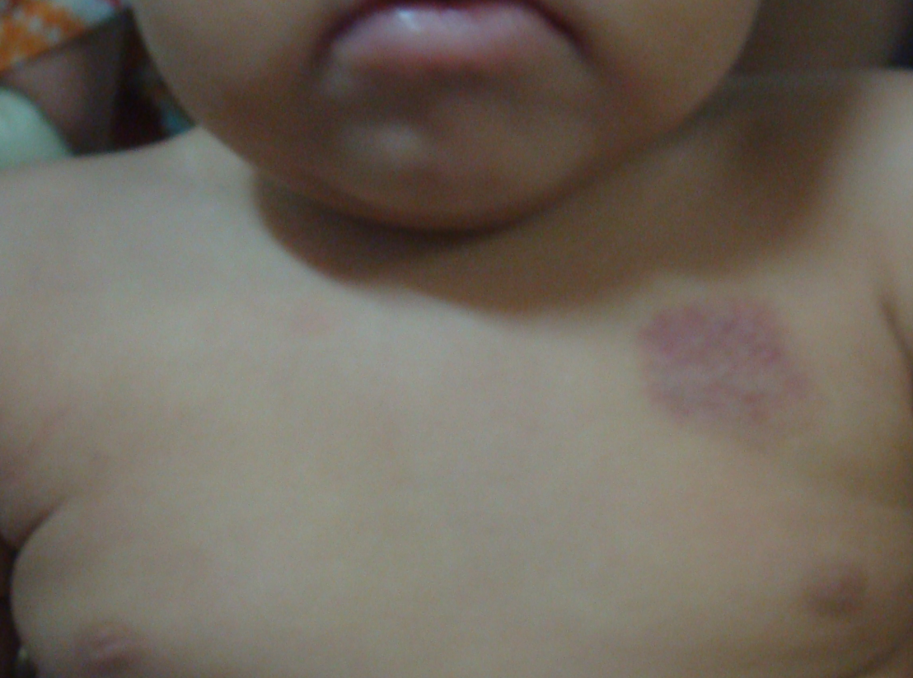

Slide 15
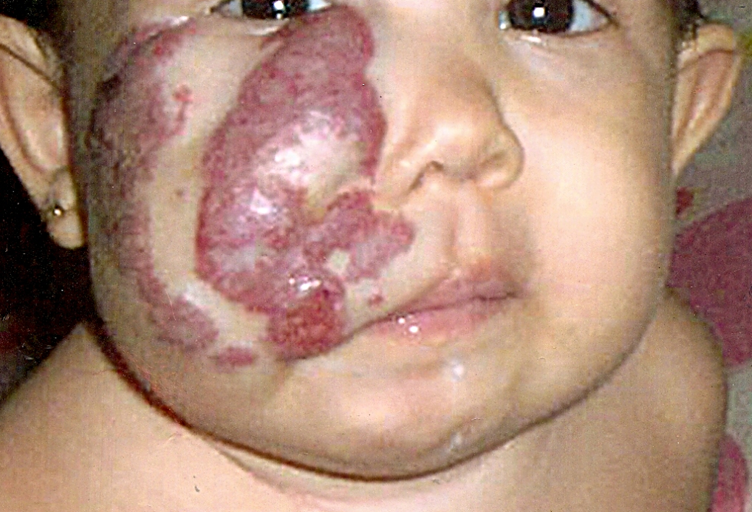
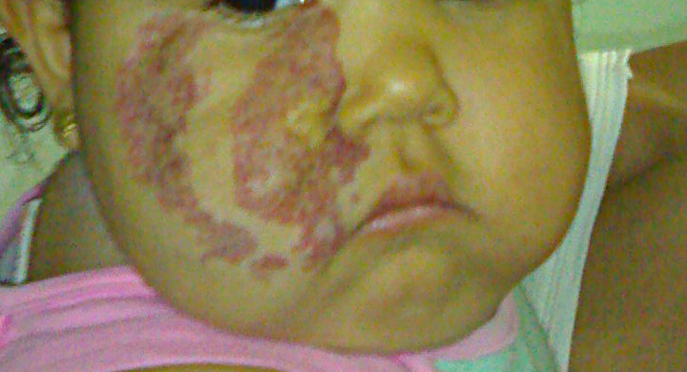
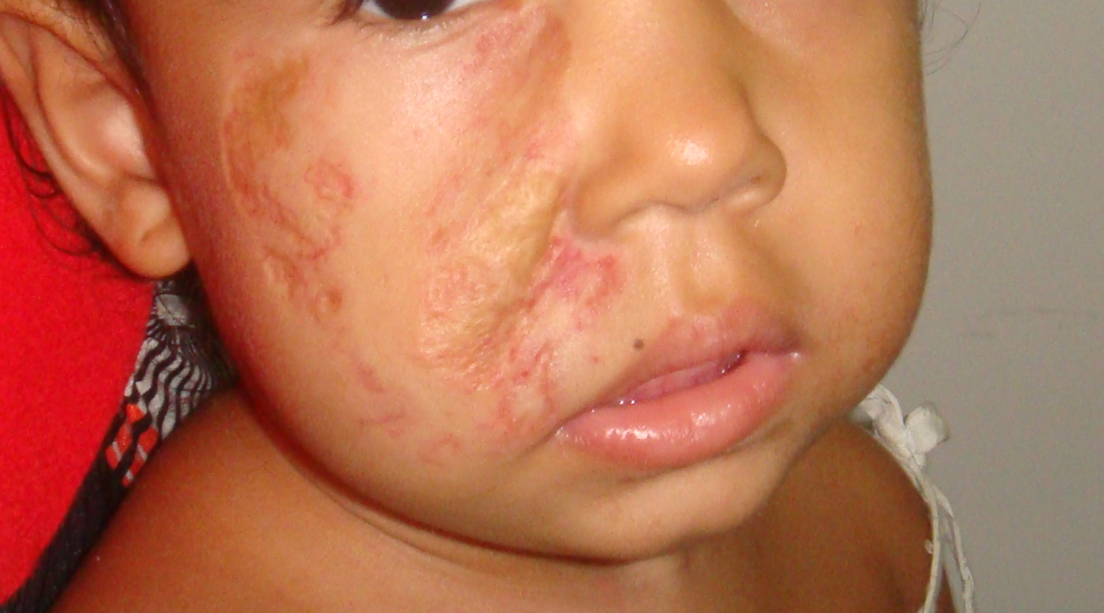

Slide 16
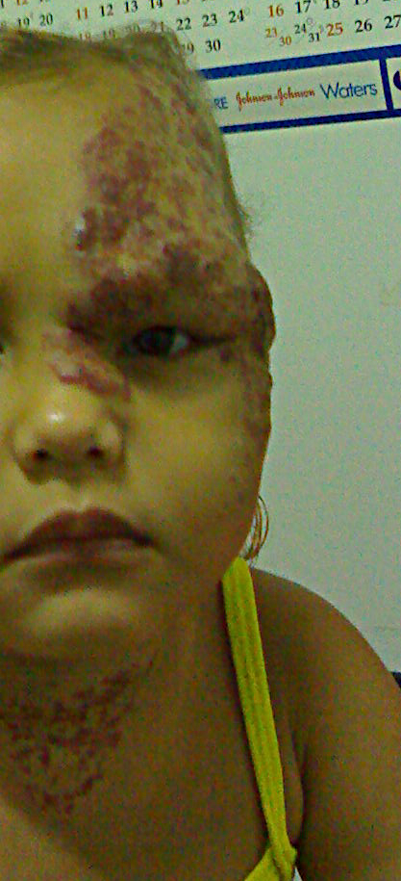
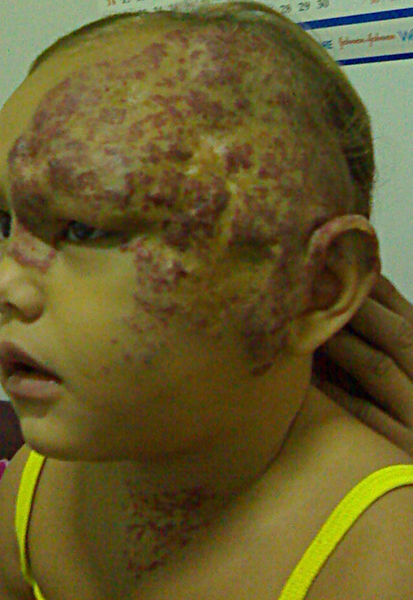
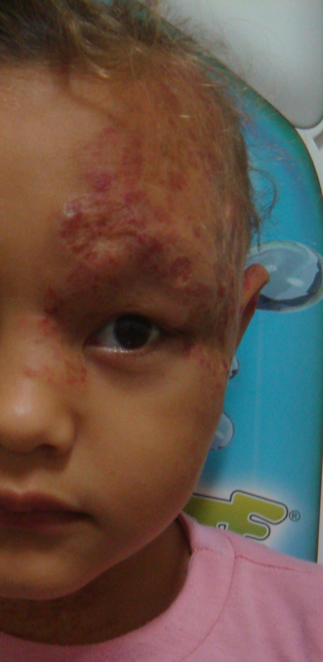
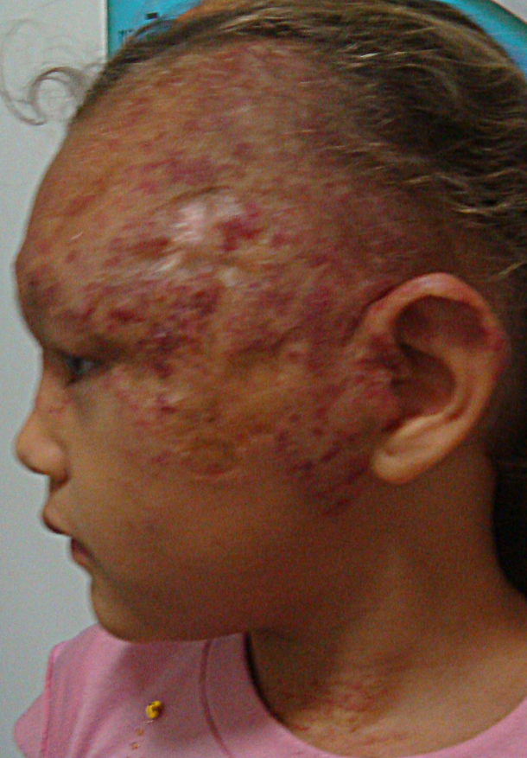

Slide 17
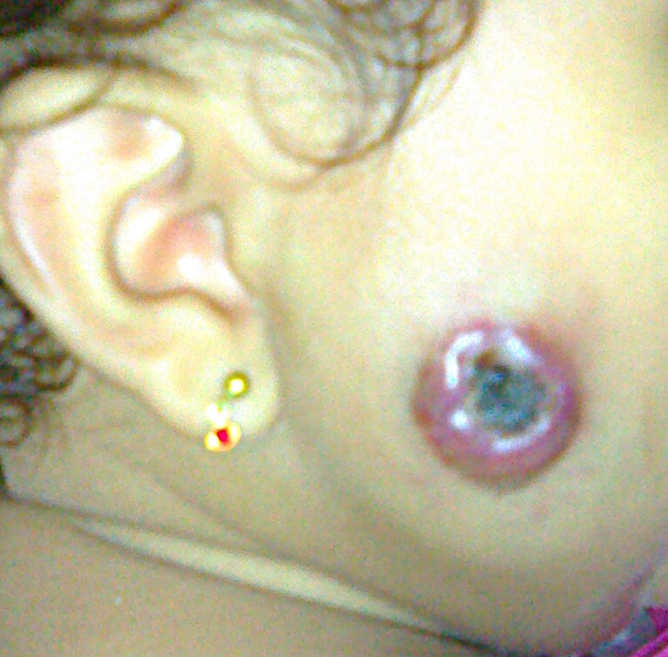
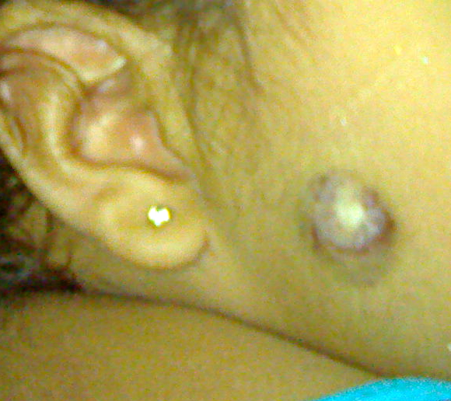

Slide 18
Propranolol
Eficiente: mais de 90% dos pacientes
Resposta rápida: na primeira semana
Resposta completa em muitos pacientes
Baixa incidência de efeitos colaterais
Broncoespasmo: ocasional, não impediu o tratamento
Hipotensão, bradicardia: não observado
Hipoglicemia: relato anedótico

Slide 19
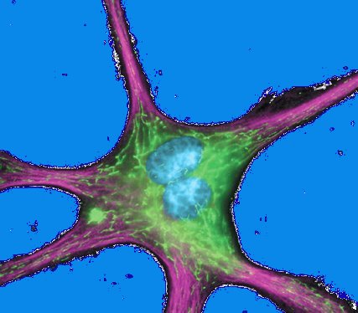
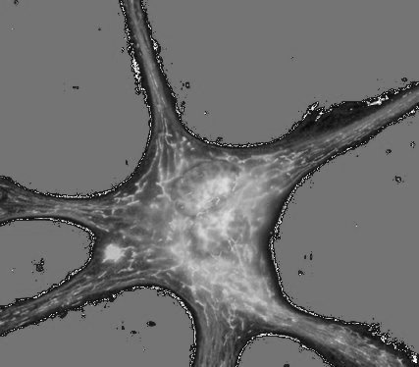
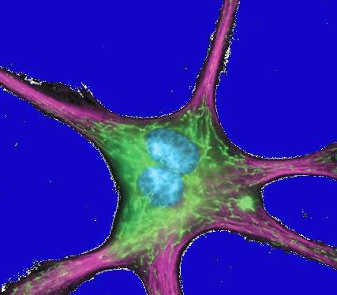
Fase Proliferativa
Fase de Estabilização
Fase de Regressão
Beta-bloqueador
MIB1+
Caspases +
ICAM1+
VEGF
bFGF
VEGF
bFGF
HIF
Célula endotelial
Stress hipóxico
Fatores genéticos
Perinatal
3-12 m
12-36 m
3-7 a
Adaptado de Léauté-Labrèze, 2008

Slide 20







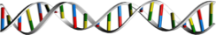
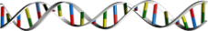
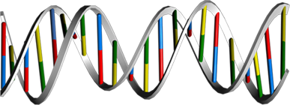

Epinephrine, Norepinephrine
-
cAMP Pathway
Cl
+
Ca²⁺
+
Na
Ca²⁺
Netrin1
K
N
N
C N G
G P C R
A D
R
SCn, KCn, ClCn, CaCn
C N G
P
Arrβ
C
+
Gα
Gβ
Gγ
Gα-Q, Gα-S
K
+
+
Na
Ca²⁺
Na
GDP
GDP
-
AC
-
Ca²⁺
Cl
Cl
ATP
Myocardial Contraction
GTP
Gα-I
Akt Signaling
cAMP
Gα-S
GTP
Akt
RGS
Metabolic Energy
DAG
PLC
PYK2
Calm
CamK2
Gβ
Gγ
PIP2
PKC
P
Raf1
CamKs
Caln
IP3
CamK4
ACI
ACV
ACVI
ACII
ACIV
ACVII
ACIII
ACVIII
ACIX
Cell Survival
14-3-3
MEK1,2
P
Cell Growth
BAD
Metabolic Energy
ATP
mTOR Signaling
Cell Survival, Chemotaxis
14-3-3/BAD Pathway
AMP
A
K
A
P
PKAR
PKAC
P
PDE
mTOR
p70S6K Pathway
Lipolysis
PKAR
PKAC
cAMP
p70S6K
Rap1 Pathway
HSL
P
PKA
P
Mep1B
cAMP GEFII
GDP
ERK
eNOS
Rap1A
PHK
PKI
cAMP GEFI
Rap2A
Rap2 Pathway
Glycogen
PYG
P
eNOS Signaling
PLA2
p38
BRaf
Glucose-1- Phosphate
Pln
Cardiovascular Homeostasis
p38 Signaling
Cell Survival
Glycolysis
CRP
Fatty Acid Metabolism
Cytokine Production
Myocardial Contraction
TnnI
P
P
P
PTP
Protein Retention
GSK3
Regulation of Cytoskeleton
RhoA
DARPP32
Rho Kinase
Caln
Ca²⁺
Oncogenesis
Adducin
Myosin II/ RLC
PPtase1
RyR
KDELR
P
GYS
IP3R
Glycogen Synthesis
Endothelial Cell Regulation
PCTK1
Ca²⁺
Ca²⁺
Cell Proliferation
14-3-3
APC
P
NFAT
P
P
P
P
P
NF-κB
P
NFAT
APC Regulation
ATF1
CREB
CREM
CBP
Elk1
2009
ProteinLounge.com
C
Cell Survival
ICER
Gene Expression
Degradation of Cell Cycle Regulators
Cell Survival
Notes:
<number>
<number>
Review:
cAMP (Cyclic Adenosine 3',5'-monophosphate) is the first identified second messenger, which has a fundamental role in the cellular response to many extracellular stimuli. The cAMP signaling pathway controls a diverse range of cellular processes. Indeed, not only did cAMP provide the paradigm for the second messenger concept, but also provided the paradigm for signaling compartmentalization. The different receptors, chiefly the GPCRs (G-Protein Coupled Receptors), Alpha and Beta-ADRs (Adrenergic Receptors), Growth Factor receptors, CRHR (Corticotropin Releasing Hormone Receptor), GcgR (Glucagon Receptor), DCC (Deleted in Colorectal Carcinoma), etc are responsible for cAMP accumulation in cells that cause different physiological outcomes, and changes in cAMP levels effects the selective activation of PKA (cAMP dependent Protein Kinase-A) isoforms. The chief source of cAMP is from ATP (Adenosine Triphosphate). In mammals, the conversion of ATP to cAMP is mediated by members of the Class-III AC (Adenylyl Cyclase)/ADCY (Adenylate Cyclase) family (E.C 4.6.1.1), which in humans comprises nine trans-membrane AC enzymes or tmACs and one soluble AC or sAC (Ref.1 & 2). The sAC predominantly occurs in mature spermatozoa. tmACs are regulated by heterotrimeric G-proteins in response to the stimulation of various types of GPCRs and therefore play a key role in the cellular response to extracellular signals. sAC, in contrast, is insensitive to G-proteins. Instead, sAC is directly activated by Ca2+ (Calcium Ions) and the metabolite HCO3- (Bicarbonate Ions), rendering the enzyme an intracellular metabolic sensor. Together, tmACs and sAC regulate a diverse set of essential biological processes, such as differentiation and gene transcription, and this makes cAMP signaling, an important mediator of intra- and extracellular signals in organisms from prokaryotes to higher eukaryotes (Ref.2 & 3).
The extracellular stimuli like neurotransmitters, hormones, inflammatory stimuli, stress, epinephrine, norepinephrine, etc activate the G-proteins through receptors like GPCRs and ADR-Alpha/Beta. The major G-proteins that regulate activation of ACs are the GN-AlphaS (GN-AlphaS Complex Locus), GN-AlphaQ (Guanine Nucleotide-Binding Protein-Alpha-Q) and GN-AlphaI (Guanine Nucleotide Binding Protein-Alpha Inhibiting Activity Polypeptide). Upon activation these subunits are separated from GN-Beta (Guanine Nucleotide-Binding Protein-Beta) and GN-Gamma (Guanine Nucleotide-Binding Protein-Gamma) subunits and are converted to their GTP bound states that exhibit distinctive regulatory features on the nine tmACs in order to regulate intracellular cAMP levels (Ref.1 & 4). Other ligands like Gcg (Glucagon), Ucns (Urocortins) and Ntn1 (Netrin-1), etc either directly regulate activity of ACs or via G-protein activation through their respective receptors like GcgR, CRHR and DCC. GN-AlphaS and GN-AlphaQ activate ACs to increase intracellular cAMP levels, where as, GN-AlphaI decrease intracellular cAMP levels by inhibiting ACs. GN-Beta and GN-Gamma subunits act synergistically with GN-AlphaS and GN-AlphaQ only to activate ACII, IV and VII. However the Beta and Gamma-subunits along with GN-AlphaI inhibit the activity of ACI, V and VI. ACI, III, V, VI and IX isoforms play a vital role in spinal pain transmission and are up-regulated by chronic Opoids, for which they are often inhibited by Ca2+ and other proteins acting downstream to cAMP signaling. GN-AlphaI activity is counteracted by RGS (Regulator of G-Protein Signaling) proteins (Ref.5, 6 & 7). However, Beta-Arrestins desensitize many GPCRs and ADRs and this blocks interaction between receptors and their cellular effectors, thereby inhibiting GPCR activity. Beta-Arrestins contol intracellular cAMP levels by switching of signaling from GN-AlphaS to GN-AlphaI by recruiting PDE4D (cAMP Specific Phosphodiesterase-4D) isoforms (Ref.8). Growth factors and PI3K (Phosphatidylinositde-3 Kinase) crosstalk with cAMP signaling by activating Akt (v-Akt Murine Thymoma Viral Oncogene Homolog), which further activates PDE (Phosphodiesterase) to facilitate the conversion of cAMP to AMP through Akt Signaling. This modulates cardiac contractility and release of metabolic energy. G-proteins indirectly influence cAMP signaling by activating PI3K and PLC (Phospholipase-C). PLC cleaves PIP2 (Phosphatidylinositol 4,5-bisphosphate) to generate DAG (Diacylglycerol) and IP3 (Inositol 1,4,5-trisphosphate). DAG in turn activates PKC (Protein Kinase-C). IP3 modulates proteins upstream to cAMP signaling with the release of Ca2+ through IP3R (IP3 Receptor) facilitating activation of Src (v-Src Avian Sacroma (Schmidt-Ruppin A-2)Viral Oncogene) along with PYK2 (Proline-Rich Tyrosine Kinase-2). Activation of Src by PI3K and growth factors enhance activation of Raf1 (v-Raf1 Murine Leukemia Viral Oncogene Homolog-1) through Ras. Raf1 facilitate MEK1 (MAPK/ERK Kinase-1) and MEK2 activation, which in turn activates ERKs (Extracellular Signal-Regulated Kinases) and this ultimately leads to induction of transcription regulator Elk1 (ETS-domain protein Elk1) mediated gene expression. PKC modulate cAMP signaling by activation of Raf1, PYK2 and ACs like ACI, II, III, V and VII, but inhibits ACVI (Ref.9).
Once active, the tmACs and sAC produces the second messenger cAMP in response to a wide range of signal transduction pathways. Three main targets of cAMP are PKA, the GTP-exchange protein, EPACs (Exchange Protein Activated by cAMP) and the CNG (Cyclic-Nucleotide Gated Ion Channel). CNG activation by cAMP provides passage to Ca2+ influx. cAMP activate Rap1A (Ras-Related Protein-1A) and Rap1B (Ras-Related Protein Rap1B) through the PKA-independent and EPAC (Exchange Protein Activated by cAMP)-dependent pathway. cAMP activates cAMP-GEFI (cAMP-Regulated Guanine Nucleotide Exchange Factor-I)/EPAC1 and cAMP-GEFII (cAMP-Regulated Guanine Nucleotide Exchange Factor-II)/EPAC2 that in turn activate Rap1A and Rap1B, respectively. Rap1A and Rap1B then forms an active complex with BRaf (v-Raf Murine Sarcoma Viral Oncogene Homolog-B1) for MEK1/2 activation finally resulting in Elk1 activation. Rap1A and Rap1B further stimulate Rap1 and Rap2 pathways that are vital for cell survival (Ref.10 & 11). Apart from CNG, PKC, and EPACs, other direct targets of cAMP includes, PDE, mTOR (Mammalian Target of Rapamycin), p70S6K/RPS6KB1 (Ribosomal Protein-S6 kinase-70kDa-Polypeptide-1), PLA2 (Phospholipase-A2). cAMP-activated mTOR and p70S6K promote cell growth via the mTOR and p70S6K signaling route, whereas, PLA2 facilitates release of stored energy by enhancing the Fatty acid metabolism processes. The Urocortin-cAMP mediated induction of PKC and p38 results in Apoptosis and Cytokine production (like that of IL-6 (Interleukin-6)), downstream to the Urocortin-cAMP pathway. Although cAMP directly regulates the activities of some molecules, PKA appears to be the major ‘read-out’ for cAMP and is the predominant cellular effector of cAMP (Ref.12). PKA is tethered to specific cellular locations by a growing class of proteins called AKAPs (A-Kinase Anchor Proteins). Targeting of PKA isozymes by AKAPs is important for an increasing number of physiological processes such as cAMP regulation of ion channels in the nervous system, regulation of the cell cycle which involves microtubule dynamics, chromatin condensation and decondensation, nuclear envelope disassembly and reassembly, Steroidogenesis, reproductive function, immune responses and numerous intracellular transport mechanisms (Ref.13).
In the following sections, the role of localized pools of PKA in the context of some selected physiological processes where regulation by cAMP plays a major role has been analyzed. The ADR-Alpha/Beta stimulation of cAMP-PKA phosphorylates several proteins related to excitation-contraction coupling like activation of L-Type CaCn (Calcium Channels), KCn (Potassium Channel), SCn (Sodium Channels), ClCn (Chloride Channels), RyR (Ryanodine Receptor), Pln (Phospholamban), CRP (C-Reactive Protein) but inhibts TnnI (Troponin-I). PKA phosphorylates Pln that regulates the activity of SERCA2 (Sarcoplasmic Reticulum Ca2+-ATPase-2). It leads to increased reuptake of Ca2+, Cl- (Chloride Ions), K+ (Potassium Ions), Na+ (Sodium Ions) and this process is affected in failing hearts. Ca2+ uptake activates Caln (Calcineurin), which further facilitates NFAT (Nuclear Factor of Activated T-Cells) translocation to the nucleus, a process that is quite essential for axonal growth. cAMP plays a vital role in regulation of cardiovascular function by controlling the process of myocardial contraction. Increase in higher concentration of Ca2+ and PKA activation enhances eNOS (Endothelial NOS) enzyme activity by phosphorylation of Serine residue (Ser635) in order to stimulate eNOS signaling, which is essential to maintain cardiovascular homeostasis (Ref.13). In mammals, Ca2+ and HCO3- play a critical role in the regulation of sperm function, most likely by regulation of cAMP levels. sAC is active in human spermatozoa and is a sensor for both HCO3- and Ca2+. Ca2+ release by CaCn and CNG, activate Calm (Calmodulin) and CamKs (Calcium/Calmodulin-Dependent Protein Kinases). Calm further activate Caln, CamK2 (Calcium/Calmodulin-Dependent Protein Kinase-II) and CamK4. These in turn modulate cAMP production by regulating the activity of ACs and PDEs. The CamKs along with Caln inhibit PDE and ACIX, whereas CamK2 and CamK4 inhibit the function of ACIX and ACI, respectively (Ref.2). ACIX is also inhibited by PKC thus controlling cAMP signaling in the hippocampal neurons. cAMP activated PKA represses ERK activation by the formation of an inactive Rap1/Raf1 that interferes with ERK activation through seizure of MEK1,2 activation by sequestering Raf1 activity. 14-3-3 like the PKA also aids the process of Raf1 inactivation. Therefore, the effect of cAMP on ERK differs depending on the balance of the Raf1, BRaf and PKA isoforms occurring inside a cell (Ref.10). Long PDE4A (cAMP Specific Phosphodiesterase-4A) isoforms are activated by cAMP, PKA and Akt kinases. The PDE sequester cAMP activity by converting it back to AMP. This negative-feedback loop terminates the cAMP signal locally. cAMP further represses the activity PDE1 (Phosphodiesterase-1) to enhance the duration and intensity of cAMP signaling (Ref.14).
cAMP follows a distinct route and activates a single PKA-AKAP complex close to the substrate to mediate a distinct biological effect. Accordingly, each substrate appears to have its own, private anchored pool of PKA and its own local gradient of cAMP. PKA inhibit the interaction of 14-3-3 proteins with BAD (through 14-3-3/BAD signaling) and NFAT to promote cell survival. PKA inhibits Adducin action by limiting its role during assembly of Spectrin-Actin network in erythrocytes, thereby reducing the chances of Erythroleukemia. It activates KDELR (KDEL (Lys-Asp-Glu-Leu) Endoplasmic Reticulum Protein Retention Receptor) to promote retrieval of proteins (protein retention) from golgi complex to endoplasmic reticulum thereby maintaining steady state of the cell. Increased cAMP levels promote survival of neuronal cells by inactivating GSK3Alpha (Glycogen Synthase Kinase-3-Alpha) and GSK3Beta (Glycogen Synthase Kinase-3-Beta) via a PKA dependent mechanism and thus prevents Oncogenesis and neurodegeneration (Ref.13 & 15). PKA interferes at different levels with other signaling pathways. Inactivation of PTP (Protein Tyrosine Phosphatase) results in dissociation from and consequent activation of ERKs. Inactivation of PCTK1 (PCTAIRE Protein Kinase-1) and APC (Anaphase-Promoting Complex) helps to maintain control cell proliferation and anaphase initiation and late mitotic events, respectively, thereby checking the degradation cell cycle regulators. PKA activation by cAMP enhances release of stored energy in cells by phosphorylation of HSL (Hormone-Sensitive Lipase) in white adipose tissue, which leads to the hydrolysis of triglycerides (vital intermediates of Tricaylglycerol Metabolism). Hydrolysis of triglycerides by HSL generates free fatty acids, the major gateway for the release of stored energy, and this process is termed as Lipolysis. Gcg binds to on the surface of liver cells and triggers an increase in cAMP production leading to an increased rate of Glycogenolysis by activating PHK (Phosphorylase Kinase) via the PKA-mediated cascade. PHK further activate PYG (Glycogen Phosphorylase), which converts Glycogen to Glucose-1-Phosphate. Phosphoglucomutase then transfers phosphate to C-6 of Glucose-1-Phosphate generating Glucose-1,6-phosphate as an intermediate. The phosphate on C-1 is then transferred to the enzyme regenerating it and Glucose-6-Phospahte is the released product that enters Glycolysis. This is the same response hepatocytes have to Epinephrine release through the ADR-Alpha/Beta. PKA further inhibits GYS (Glycogen Synthase) leading to seizure of energy consuming process like Glycogen Synthesis (Ref.13 & 16).
Upon stimulation from hormones, cAMP increases phosphorylation of RhoA that inactivates Rho Kinase. Rho Kinase regulates Myosin-II and cell contraction by catalyzing phosphorylation of the regulatory subunit of Myosin phosphatase, PPtase1 (Protein Phosphatase-1), by inhibiting its catalytic activity, which results in an indirect increase in RLC (Regulatory Light Chain of Myosin) phosphorylation. Inactivation of Rho Kinase also directly increases RLC phosphorylation. Such increased intracellular cAMP and PKA activation on RLC phosphorylation decreases Thrombin-induced isometric tension development in endothelial cells and this decrease the development of Edema, a hallmark of acute and chronic inflammation (Ref.17). Interestingly, PKA controls phosphatase activity by phosphorylation of specific PPtase1 inhibitors, such as DARPP32 (Dopamine-and cAMP-Regulated Phosphoprotein). Neurotransmitters enhance DARPP32 interaction via GPCRs, which leads to suppression of PPtase1 activity, when DARPP32 is phosphorylated at Thr-34 (Threonine-34) position. Phosphorylation is a crucial event in transcriptional activation by CREB (cAMP Response Element-Binding Protein), CREM (cAMP Response Element Modulator) and ATF1 (Activating Transcription Factor-1), because it allows interaction with the transcriptional co-activators CBP (CREB-Binding Protein) and p300. CREM gene encodes many different isoforms, some of which have repressive functions. Particularly the repressor ICER (Inducible cAMP Early Repressor), participates in the downregulation of cAMP-induced transcription by competing with the binding of CREB and CREM activators to their DNA binding sites. PPtase1 checks the phosphorylation events in order to inactivate the formation of repressor isoforms like ICER so that CREB, CREM and ATF1 are able to interact with the co-activators like CBP and p300. Hence, under physiological conditions, ICER induction is a transient phenomenon that allows cAMP signaling to return to the basal state. In contrast, prolonged or inappropriate induction of ICER elicits pathological consequences (Ref.18). Similarly, phosphorylation of NK-KappaB (Nuclear Factor-KappaB) by PKA is necessary for transcriptional activation and interaction with CBP. PKA modulates the activity of transcription factors, such as nuclear receptors and HMG (High Mobility Group)-containing proteins, influencing their dimerization or DNA-binding properties. A peculiar example is the mechanism by which PKA regulates Gli3 (Gli-Kruppel Family Member-3) under the influence from Hedgehog signaling. Function of Gli3 is similar to that of Drosophila gene CI (Cubitus Interruptus) activity. In this case phosphorylation stimulates a specific cleavage of Gli3 which transforms the protein from an activator to a repressor. However, proteins like PKIs (Protein Kinase Inhibitors) and Mep1B (Meprin-A-Beta) down regulate PKA activity to prevent aberrant gene expression (Ref.13 & 16).
Normally, the level of intracellular cAMP is regulated by the balance between the activities of two types of enzymes; ACs and the cyclic nucleotide PDEs chiefly in response to hormones and neurotransmitters. The cAMP signaling is involved in controlling exocytotic events in polarized epithelial cells with implication for Diabetes Insipidus, Hypertension, Gastric ulcers, Thyroid disease, Diabetes Mellitus, and Asthma. Heterologous sensitization of cAMP signaling contributes to fundamental physiological processes such as the timing of circadian rhythms, sexual behavior, and neurotransmitter crosstalk, and also to neurological disorders such as substance abuse and drug-induced Dyskinesias (Ref.19). This provide insight into the mechanisms of addiction and many other central nervous system disorders reflective of altered neuronal cell functioning. Besides it also represent very likely roles for ACs and open up avenues for therapeutics targeting ACs that may prove useful in the development of male contraceptives (Ref.1 & 20).
References:
1. Watts VJ, Neve KA.
Sensitization of adenylate cyclase by Galpha i/o-coupled receptors.
Pharmacol. Ther. 2005 Jun;106(3):405-21.
PubMed ID: 15922020
2. Jaiswal BS, Conti M.
Calcium regulation of the soluble adenylyl cyclase expressed in mammalian spermatozoa.
Proc. Natl. Acad. Sci. U S A. 2003 Sep 16;100(19):10676-81.
PubMed ID: 12958208
3. Baillie GS, Houslay MD.
Arrestin times for compartmentalised cAMP signalling and phosphodiesterase-4 enzymes.
Curr. Opin. Cell Biol. 2005 Apr;17(2):129-34.
PubMed ID: 15780588
4. Pullar CE, Isseroff RR.
Cyclic AMP mediates keratinocyte directional migration in an electric field.
J. Cell Sci. 2005 May 1;118(Pt 9):2023-34.
PubMed ID: 15840650
5. Bie B, Peng Y, Zhang Y, Pan ZZ.
cAMP-mediated mechanisms for pain sensitization during opioid withdrawal.
J. Neurosci. 2005 Apr 13;25(15):3824-32.
PubMed ID: 15829634
6. Cumbay MG, Watts VJ.
Galphaq potentiation of adenylate cyclase type 9 activity through a Ca2+/calmodulin-dependent pathway.
Biochem. Pharmacol. 2005 Apr 15;69(8):1247-56.
PubMed ID: 15794946
7. Yamada RX, Matsuki N, Ikegaya Y.
cAMP differentially regulates axonal and dendritic development of dentate granule cells.
J. Biol. Chem. 2005 Nov 11;280(45):38020-8.
PubMed ID: 16155295
8. Dessauer CW, Nguyen BT.
Relaxin stimulates multiple signaling pathways: activation of cAMP, PI3K, and PKCzeta in THP-1 cells.
Ann. N Y. Acad. Sci. 2005 May;1041:272-9.
PubMed ID: 15956717
9. Leblais V, Jo SH, Chakir K, Maltsev V, Zheng M, Crow MT, Wang W, Lakatta EG, Xiao RP.
Phosphatidylinositol 3-kinase offsets cAMP-mediated positive inotropic effect via inhibiting Ca2+ influx in cardiomyocytes.
Circ. Res. 2004 Dec 10;95(12):1183-90.
PubMed ID: 15539636
10. Kim SS, Choi JM, Kim JW, Ham DS, Ghil SH, Kim MK, Kim-Kwon Y, Hong SY, Ahn SC, Kim SU, Lee YD, Suh-Kim H.
cAMP induces neuronal differentiation of mesenchymal stem cells via activation of extracellular signal-regulated kinase/MAPK.
Neuroreport. 2005 Aug 22;16(12):1357-61.
PubMed ID: 16056139
11. Kiermayer S, Biondi RM, Imig J, Plotz G, Haupenthal J, Zeuzem S, Piiper A.
Epac Activation Converts cAMP from a Proliferative into a Differentiation Signal in PC12 Cells.
Mol. Biol. Cell. 2005 Oct 5.
PubMed ID: 16207818
12. Malbon CC, Tao J, Wang HY.
AKAPs (A-kinase anchoring proteins) and molecules that compose their G-protein-coupled receptor signalling complexes.
Biochem. J. 2004 Apr 1;379(Pt 1):1-9.
PubMed ID: 14715081
13. Tasken K, Aandahl EM.
Localized effects of cAMP mediated by distinct routes of protein kinase A.
Physiol. Rev. 2004 Jan;84(1):137-67.
PubMed ID: 14715913
14. Dumaz N, Marais R.
Integrating signals between cAMP and the RAS/RAF/MEK/ERK signalling pathways.
FEBS J. 2005 Jul;272(14):3491-504.
PubMed ID: 16008550
15. Chin PC, Majdzadeh N, D'Mello SR.
Inhibition of GSK3beta is a common event in neuroprotection by different survival factors.
Brain. Res. Mol. Brain Res. 2005 Jun 13;137(1-2):193-201.
PubMed ID: 15950778
16. Taylor SS, Kim C, Vigil D, Haste NM, Yang J, Wu J, Anand GS.
Dynamics of signaling by PKA.
Biochim. Biophys. Acta. 2005 Sep 22.
PubMed ID: 16214430
17. Goeckeler ZM, Wysolmerski RB.
Myosin phosphatase and cofilin mediate cAMP/cAMP-dependent protein kinase-induced decline in endothelial cell isometric tension and myosin II regulatory light chain phosphorylation.
J. Biol. Chem. 2005 Sep 23;280(38):33083-95.
PubMed ID: 16055445
18. Ding B, Abe J, Wei H, Xu H, Che W, Aizawa T, Liu W, Molina CA, Sadoshima J, Blaxall BC, Berk BC, Yan C.
A positive feedback loop of phosphodiesterase 3 (PDE3) and inducible cAMP early repressor (ICER) leads to cardiomyocyte apoptosis.
Proc. Natl. Acad. Sci. U S A. 2005 Oct 11;102(41):14771-6.
PubMed ID: 16186489
19. Shankar DB, Cheng JC, Sakamoto KM.
Role of cyclic AMP response element binding protein in human leukemias.
Cancer. 2005 Nov 1;104(9):1819-24.
PubMed ID: 16196046
20. Linder JU, Schultz JE.
The class III adenylyl cyclases: multi-purpose signalling modules.
Cell. Signal. 2003 Dec;15(12):1081-9.
PubMed ID: 14575863

Slide 21
VEGF Pathway
VEGFA,
VEGFC,
VEGFD
VEGFR2
PIP2
P
PLCγ
PIP2
PIP3
PI3K
P
Endothelial Cell
VRAP
Src
P
Sck
IP3
DAG
GRB2
MKK3/6
SHC
SOS
Akt/
PKB
FAK
Ca²⁺
Paxillin
PKC
P
p38
Ras
P
Focal Adhesion Turnover
ProstaglandinProduction
P
eNOS
Raf1
BAD
HSP90
MAPKAPK2/3
P
Cell Migration
Caspase9
MEK1/2
Nitric Oxide
Production
HSP27
cPLA
Cell Survival
ERK1/2
Actin
Reorganization
Gene Expression & Cell Proliferation
Vascular Cell Permeability
ANGIOGENESIS
2009
ProteinLounge.com
C
Notes:
<number>
<number>
Review:
The formation of blood vessels occurs either by in situ differentiation of endothelial cell precursors (Angioblasts) and association of these cells to form primitive vessels, a process called Vasculogenesis, or by growth of preexisting vessels, a process called Angiogenesis. Vasculogenesis establishes the primary vascular plexus of the early embryo, whereas development of blood vessels during later embryogenesis and adult life occurs primarily by Angiogenesis. Angiogenesis is an integral feature of capillary sprouts from preexisting blood vessels. It is typically quiescent in the adult, except for pathological situations (e.g., wound healing, Diabetic Retinopathy, Rheumatoid Arthritis, Cardiac Ischemia, Psoriasis, tumor growth) and during menstrual cycle-specific physiological processes in the female reproductive system (e.g., ovulation, endometrial growth, implantation, placentation) (Ref.1 & 2). Once blood vessels have been established, endothelial cells undergo tissue-specific changes to generate numerous types of functionally distinct vessels as organs differentiate. These processes require that endothelial cells respond to a variety of extracellular signals that activate receptors responsible for growth and differentiation (Ref.3). VEGF (Vascular Endothelial Growth Factor), Angiopoietin and Ephrin are key molecules in the promotion of angiogenesis via activation of the VEGFR (VEGF Receptor), TIE and Ephrin expressed on vascular endothelial cells, respectively (Ref.4). VEGF signaling plays a major role in promoting the proliferation and differentiation of the endothelial lineage from the earliest stages of development, whereas the Angiopoietin/TIE2 pathway acts slightly later to promote the recruitment of supporting cells and vessel stabilization. However, the complex patterning of the developing vasculature also requires specific vascular roles for the components of other signaling pathways, including the Ephrin, TGF-Beta (Transforming Growth Factor- Beta), PDGF (Platelet-Derived Growth Factor), FGF (Fibroblast Growth Factor), and Delta-Notch Pathways (Ref.6).
VEGF is a heparin-binding homodimeric glycoprotein that acts via endothelial-specific receptor tyrosine kinases, VEGFR1 (Flt1), VEGFR2 (KDR/Flk1), and VEGFR3 (Flt4) (Ref.3). Besides VEGFA, the VEGF family of growth factors currently contains five other known members, namely PlGF (Placenta Growth Factor), VEGFB, VEGFC, VEGF-D and orf viral VEGF homologs. Additional novel VEGF-like heparin-binding proteins have been isolated recently from snake venom. Disruption of the genes encoding either VEGF or any of the three receptors of the VEGF family, results in embryonic lethality because of failure of blood vessel development. VEGFR2 is the main signal transducing VEGF receptor for angiogenesis and mitogenesis of endothelial cells. After receptor dimerization and autophosphorylation, several SH2 domain-containing signal transduction molecules are activated either directly such as PLC-gamma, VRAP (VEGF Receptor-Associated Protein), and Sck, or by indirect mechanisms, such as Src and PI3K (Phosphatidylinositol 3-Kinase). Activation of PKC (Protein Kinase-C) plays a crucial role in VEGFA mitogenic signaling via the Raf1-MEK-ERK pathway. Cell survival signal is mainly mediated through PI3K-mediated activation of Akt/PKB (Protein Kinase-B). Activation of PI3K results in accumulation of PIP3 (Phosphatidylinositol-3, 4, 5-Trisphosphate), which in turn mediates membrane targeting and phosphorylation of Akt/PKB by binding to its PH (Pleckstrin Homology) domain. Downstream targets for Akt/PKB pathway include the proapototic proteins BAD, FKHR1 (Forkhead Transcription Factor-1), and Caspase-9, whose phosphorylation inhibits apoptosis. Moreover, VEGFA induces expression of the antiapoptotic protein BCL2 and the IAP (Inhibitor of Apoptosis Protein) family members XIAP (Xenopus Inhibitor of Apoptosis), and Survivin in HUVEC (Human Umbilical Vein Endothelial) cells, suggesting that these proteins also play an important role in endothelial cell survival (Ref.5). PLC-Gamma catalyzes the hydrolysis of PIP2 (Phosphatidylinositol-4, 5-Bisphosphate), creating IP3 (Inositol Trisphosphate) and DAG (Diacylglycerol), which stimulate the release of Ca2+ from internal stores and activate PKC. VEGF-A-induced Ca2+ mobilization is involved in short-term production of Nitric Oxide and Ptg (Prostaglandin). SHC phosphorylation promotes formation of SHC-GRB2 (Growth Factor Receptor-Bound Protein-2)-SOS complexes and induces PKC-dependent and Ras-independent induction of the Raf1-MEK-ERK1/2 pathway in sinusoidal endothelial cells and in HUVEC cells (Ref.5). Negative feedback for the mitogenic effects of VEGF is provided by cPLA2 (cytosolic Phospholipase-A2), activation and biosynthesis of Prostaglandin. p38 pathway conveys the VEGF signal to microfilaments inducing rearrangements of the Actin cytoskeleton that regulate endothelial cell migration by modulating the activation of MAPKAPK2/3 (MAP Kinase Activated Protein Kinase-2/3) and phosphorylation of the F-Actin polymerization modulator, HSP27 (Heat Shock Protein-27). The activation of FAK (Focal Adhesion Kinase) and Paxillin by VEGFA in HUVE cells through VEGFR2 leads to recruitment of Actin-anchoring proteins such as Talin and Vinculin to the focal adhesion plaque, which are essential for VEGFA-induced actin reorganization. VEGFA also stimulates tyrosine phosphorylation of the FAK-related cytoplasmic tyrosine kinase PYK2 (also termed RAFTK, "Related Adhesion Focal Tyrosine Kinase") in a bone marrow endothelial cell line (Ref.5).
Although VEGF is known to be a powerful growth factor for therapeutic angiogenesis/vascularization in the ischemic hind limb and myocardium, it has other activities that can increase the proliferation and permeability of capillary endothelial cells. These activities may produce unwanted side effects, such as tumor angiogenesis, vascular leakage, edema, and inflammation (Ref.9). Different cytokines including VEGFA, have been reported to modulate Kaposi's Sarcoma (KS), a major vascular tumor commonly associated with HIV1 (Human Immunodeficiency Virus) and HHV-8 (Human Herpes Virus) (Ref.7 & 8). In endothelial cells, the VEGF-Flk1/KDR signal system is a very important generator of NO (Nitric Oxide) through the activation of its downstream effectors PI3K, Akt kinase and eNOS (endothelial NO Synthase). NO regulates hematopoiesis and modulates AML (Acute Myeloid Leukaemia) cell growth (Ref.10). VEGF also play a major role in the progression of ovarian cancer and colon cancer by modulating tumor proliferation through its promotion of tumor angiogenesis. In a variety of human pathological situations that are associated with aberrant endothelial proliferation and aberrant neovascularization VEGF-based therapy to treat diseases include the use of neutralizing antibodies against VEGFA or VEGFR2, antisense oligonucleotides, negative regulatory peptides, soluble receptors, and ATP analogs to inhibit the kinase activity of VEGFR (Ref.5). However, inhibition of VEGF function may result in infertility by blockade of Corpus Luteum function. Interference with VEGF function has therefore become of major interest for drug development to block angiogenesis and targeting the VEGF signaling pathway may be of therapeutic importance for many diseases.
References:
1. Mueller MD, Vigne JL, Minchenko A, Lebovic DI, Leitman DC, Taylor RN.
Regulation of vascular endothelial growth factor (VEGF) gene transcription by estrogen receptors alpha and beta.
Proc Natl Acad Sci U S A. 2000 Sep 26; 97(20): 10972-7.
PubMed ID: 10995484
2. Voelkel NF, Vandivier RW, Tuder RM.
Vascular endothelial growth factor in the lung.
Am. J. Physiol. Lung Cell Mol Physiol. 2006 Feb;290(2):L209-21.
PubMed ID: 16403941
3. Shida A, Fujioka S, Ishibashi Y, Kobayashi K, Nimura H, Mitsumori N, Suzuki Y, Kawakami M, Urashima M, Yanaga K.
Prognostic significance of vascular endothelial growth factor D in gastric carcinoma.
World J. Surg. 2005 Dec;29(12):1600-7.
PubMed ID: 16311850
4. Endo A, Nagashima K, Kurose H, Mochizuki S, Matsuda M, Mochizuki N.
Sphingosine 1-phosphate induces membrane ruffling and increases motility of human umbilical vein endothelial cells via vascular endothelial growth factor receptor and CrkII.
J. Biol. Chem. 2002 Jun 28; 277(26): 23747-54.
PubMed ID: 11956190
5. Matsumoto T, Claesson-Welsh L.
VEGF receptor signal transduction.
Sci. STKE. 2001 Dec 11; 2001(112): RE21.
PubMed ID: 11741095
6. Uyttendaele H, Ho J, Rossant J, Kitajewski J.
Vascular patterning defects associated with expression of activated Notch4 in embryonic endothelium.
Proc. Natl. Acad. Sci U S A. 2001 May 8; 98(10): 5643-8.
PubMed ID: 11344305
7. Ganju RK, Munshi N, Nair BC, Liu ZY, Gill P, Groopman JE.
Human immunodeficiency virus tat modulates the Flk-1/KDR receptor, mitogen-activated protein kinases, and components of focal adhesion in Kaposi's sarcoma cells.
J. Virol. 1998 Jul; 72(7): 6131-7.
PubMed ID: 9621077
8. Rusnati M, Urbinati C, Musulin B, Ribatti D, Albini A, Noonan D, Marchisone C, Waltenberger J, Presta M.
Activation of endothelial cell mitogen activated protein kinase ERK(1/2) by extracellular HIV-1 Tat protein.
Endothelium. 2001;8(1):65-74.
PubMed ID: 11409852
9. Chae JK, Kim I, Lim ST, Chung MJ, Kim WH, Kim HG, Ko JK, Koh GY.
Coadministration of angiopoietin-1 and vascular endothelial growth factor enhances collateral vascularization.
Arterioscler Thromb. Vasc. Biol. 2000 Dec; 20(12): 2573-8.
PubMed ID: 11116055
10. Koistinen P, Siitonen T, Mantymaa P, Saily M, Kinnula V, Savolainen ER, Soini Y.
Regulation of the acute myeloid leukemia cell line OCI/AML-2 by endothelial nitric oxide synthase under the control of a vascular endothelial growth factor signaling system.
Leukemia. 2001 Sep; 15(9): 1433-41.
PubMed ID: 11516104

Slide 22
HIF1α Pathway
2009
ProteinLounge.com
C
MKK3
MKK6
HSP70
P
P
Normoxia
TCP1α
VHL
Elongin-B
P
Hypoxia
VHL
ERK2
Elongin-C
PHD2
PHD1
Elongin-B
Ref1
VHL
Elongin-C
FIH1
OH
Ub
Ub
Cul2
RBX1
HIF1α
Ub
Ub
Ub
HIF1α
HSP90
OH
HIF1α
PSM-α7
Proteasome
P
Ub
p53
Hypoxia
Pathway
HIF1α
MDM2
p53
ARNT
HIF1α
Degradation
Per1
JAB1
ET1
HIF1α
Asparagine
Hydroxylase
HNF4α2
Epo
SRC1
p16(INK4A)
ARNT
HIF1α
VEGF
Pathway
VEGF
HIF1α
CREB
p300
CBP
Gene Expression
NOSIII
HRE
NOS Pathway
c-Jun
Notes:
<number>
<number>
Review:
The cellular response to O2 (oxygen) is a central process in animal cells and figures prominently in the pathophysiology of several diseases, including cancer, cardiovascular disease, and stroke. This process is coordinated by the HIF (Hypoxia-Inducible Factor) and its regulator, the pVHL (Von Hippel-Lindau tumor suppressor protein). HIF1 is a basic helix-loop-helix transcription factor that transactivates genes encoding proteins that participate in homeostatic responses to hypoxia. It induces expression of proteins controlling glucose metabolism, cell proliferation, and vascularization. Several genes involved in cellular differentiation are directly or indirectly regulated by hypoxia. These include Epo (Erythropoietin), LDHA (Lactate Dehydrogenase-A), ET1 (Endothelin-1), transferrin, transferrin receptor, VEGF (Vascular Endothelial Growth Factor), Flk1, FLT1 (Fms-Related Tyrosine Kinase-1), PDGF-Beta (Platelet-Derived Growth Factor-Beta), bFGF (basic Fibroblast Growth Factor), and others genes affecting glycolysis (Ref.1).
HIF1 consists of a heterodimer of two basic helix-loop-helix PAS (Per-ARNT-Sim) proteins, HIF1-Alpha, and HIF1-Beta. HIF1-Alpha accumulates under hypoxic conditions whereas HIF1-Beta is constitutively expressed. HIF1-Alpha is an important mediator of the hypoxic response of tumor cells and controls the up-regulation of a number of factors important for solid tumor expansion including the angiogenic factor VEGF. HIF1-Beta is the ARNT (Aryl hydrocarbon Receptor Nuclear Translocator), an essential component of the xenobiotic response (Ref.2).
In the presence of O2, HIF is targeted for destruction by an E3 ubiquitin ligase containing the pVHL. Human pVHL binds to a short HIF-derived peptide when a conserved proline residue at the core of this peptide is hydroxylated. The human genome contains EGL9 (Egg Laying Nine-9) homologues that are named EGLN1, EGLN2, and EGLN3 (also called PHD2, PHD1, and PHD3 (Prolyl Hydroxylase Domain–Containing Proteins) respectively). Prolyl hydroxylase post-translationally modifies HIF1-Alpha, allowing it to interact with the VHL complex. Prolyl hydroxylase contains an iron moiety, so iron chelation inhibits this activity. All three proteins of Prolyl hydroxylase can hydroxylate HIF1-Alpha at one of two proline sites within the ODD (Pro-402 and Pro-564). Analogous prolyl residues are present in HIF2-Alpha and HIF3-Alpha. In the presence of oxygen, the EGLN proteins are active and hydroxylate the ODD domain of HIF1-Alpha, which allows pVHL to bind and polyubiquitinate HIF (Ref.3). VHL is part of a larger complex that includes Elongin-B, Elongin-C, Cul2, RBX1 (Ring-Box 1) and a ubiquitin-conjugating enzyme (E2). This complex, together with a ubiquitin-activating enzyme (E1), mediates the Ub (Ubiquitylation) of HIF1-Alpha. The Ub modification targets HIF1-Alpha for degradation, which can be blocked by proteasome inhibitors. Under hypoxic conditions the HIF1-Alpha subunits are not recognized by pVHL, and they consequently accumulate and dimerize with HIF1-Beta and translocates to the nucleus, where they interacts with cofactors such as CBP (CREB Binding Protein)/p300 and the Pol II (DNA polymerase II) complex to bind to HREs (Hypoxia-Responsive Element) and activate transcription of target genes. HIF1-Alpha-activated genes include VEGF, which promotes angiogenesis; GLUT1 (Glucose Transporter-1), which activates glucose transport; LDHA (Lactate Dehydrogenase), which is involved in the glycolytic pathway; and Epo, which induces erythropoiesis. HIF1-Alpha also activates transcription of NOS (Nitric Oxide Synthase), which promotes angiogenesis and vasodilation. ARNT2 and MOP3 (Member of Pas superfamily-3) are other proteins that have been shown to heterodimerize with HIF1-Alpha (Ref.4). HIF1-Alpha can also be regulated by ERK2, which phosphorylate HIF1-Alpha. HIF1-Alpha also associates with the molecular chaperone HSP90 (Heat Shock Protein-90). HSP90 antagonists also inhibited HIF1-Alpha transcriptional activity and dramatically reduced both hypoxia-induced accumulation of VEGF mRNA and hypoxia-dependent angiogenic activity. Recently, a factor inhibiting HIF1-Alpha activation, FIH (Factor Inhibiting HIF1-Alpha), has been described, representing a further level of HIF regulation.
Hypoxia also induces p53 protein accumulation. p53 directly interacts with HIF1-Alpha and limits hypoxia-induced expression of HIF1-Alpha by promoting MDM2-mediated ubiquitination and proteasomal degradation under hypoxic conditions. Furthermore, the degradation of HIF1-Alpha by p53 in a hypoxic condition is inhibited by direct interaction with the JAB1 (Jun Activation domain Binding protein-1) and the ODD domain by blocking the interaction with p53. HIF1-Alpha also associates with HNF4alpha2 (Hepatocyte Nuclear Factor-4-Alpha 2), which activates the Epo gene in concert with HIF1-Alpha in response to hypoxic conditions. Hypoxia contributes significantly to the pathophysiology of major categories of human disease, including myocardial and cerebral ischemia, cancer, pulmonary hypertension, congenital heart disease and chronic obstructive pulmonary diseases (Ref.5).
References:
1. Jiang BH, Zheng JZ, Leung SW, Roe R, Semenza GL.
Transactivation and inhibitory domains of hypoxia-inducible factor 1alpha. Modulation of transcriptional activity by oxygen tension.
J. Biol. Chem. 1997 Aug 1;272(31):19253-60.
PubMed ID: 9235919
2. John F. O'Rourke, Ya-Min Tian, Peter J. Ratcliffe, and Christopher W. Pugh
Oxygen-regulated and transactivating domains in endothelial PAS protein 1: comparison with hypoxia-inducible factor-1alpha.
J. Biol. Chem. 1999 Jan 22;274(4):2060-71.
PubMed ID: 9890965
3. Masson N, Willam C, Maxwell PH, Pugh CW, Ratcliffe PJ
Independent function of two destruction domains in hypoxia-inducible factor-alpha chains activated by prolyl hydroxylation.
EMBO J. 2001 Sep 17;20(18):5197-206.
PubMed ID: 11566883
4. Damert A, Ikeda E, Risau W.
Activator-protein-1 binding potentiates the hypoxia-induciblefactor-1-mediated hypoxia-induced transcriptional activation of vascular-endothelial growth factor expression in C6 glioma cells.
Biochem. J. 1997 Oct 15;327 ( Pt 2):419-23.
PubMed ID: 9359410
5. Semenza GL.
Hypoxia-inducible factor 1: oxygen homeostasis and disease pathophysiology.
Trends Mol. Med. 2001 Aug;7(8):345-50
PubMed ID: 11516994

Slide 23
Inhibition of Angiogenesis by TSP1
TGFβ
Inactive
Inactive
Extracellular Matrix
MMP9
TSP1
Active
MMP9
VEGF
TSP1
TSP1
TSP1
TGFβ
Active
Heparan Sulphate
Proteoglycans
C
D
4
7
C
D
4
7
T
G
F
Β
R
T
G
F
Β
R
V
E
G
F
R
2
Fyn
Caspase3
VEGF
Pathway
TGFβ
Pathway
p38
p38
P
Apoptosis
Angiogenesis
Tumor
Suppression
Gene
Expression
c-Jun
c-Fos
2009
ProteinLounge.com
C
Notes:
<number>
<number>
Review:
Cancer is a multistep process that includes deregulation of cell cycle, transformation, invasion of stroma, angiogenesis and metastasis. Angiogenesis is an essential component for tumor development regulated by both proangiogenic and antiangiogenic factors (Ref.1). It is a multi-step process that includes endothelial cell proliferation, migration, basement membrane degradation, and new lumen organization. Naturally occurring inhibitors of angiogenesis i.e., antiangiogenic factors are found in mammalian tissues, where they help maintain the quiescence of the normal vasculature. Thus, angiogenic inhibitors have been considered as potential anticancer drugs. TSP1 (Thrombospondin-1) is a naturally occurring inhibitor of angiogenesis that limits vessel density in normal tissues and curtails tumor growth (Ref.2).
Thrombospondins are a family of extracellular matrix proteins that have diverse effects on cell adhesion, motility, proliferation, and survival. Two members of this family, TSP1 and TSP2 act as inhibitors of angiogenesis (Ref.3). TSP1 is a large, multifunctional glycoprotein that influences cellular phenotype and the structure of the extracellular matrix. These effects are important components of the tissue remodeling that is associated with angiogenesis and neoplasia. TSP1 inhibits angiogenesis through direct effects on endothelial cell migration and survival and through indirect effects on growth factor mobilization. The TSP1 that is produced by stromal fibroblasts, endothelial cells and immune cells, suppresses tumor progression. In the tumor microenvironment, TSP1 acts to suppress tumor cell growth through activation of TGF-Beta (Transforming Growth Factor-Beta) in those tumor cells that are responsive to TGF-Beta (Ref.4).
TSP1 binds to a wide variety of integrin and non-integrin cell surface receptors. The binding sites for these receptors on TSP1 are dispersed throughout the molecule, with most domains binding multiple receptors. In some cases, TSP1 can also bind to multiple receptors concurrently (Ref.5). The inhibitory effects of TSP1 are mediated by the binding of TSP1 to an array of cell-surface receptors, including CD36, CD47, and heparan sulfate proteoglycan receptors (Ref.3). The induction of apoptosis by TSP1 in endothelial cells requires the sequential activation of CD36, the Src-family tyrosine kinase: p59Fyn, Caspase3 like proteases and p38 MAPK (Mitogen-Activated Protein Kinases). This is accomplished, perhaps through the activation of Activator complex-1 (c-Jun and c-Fos) and the subsequent activation of genes that lead to apoptosis. Induction of apoptosis is regarded an essential substep for the inhibition of angiogenesis by TSP1. Caspase-3-like protease is required for the activation of p38MAPK (Ref.2). TSP1 induces a rapid and transient activation of JNK (c-Jun N-terminal Kinases). JNK activation by TSP1 also requires engagement of CD36 (Ref.6).
In tumors, TSP1 that is secreted by stromal cells and some tumor cells directly inhibits endothelial cell migration and survival, that stimulates endothelial cell apoptosis. These effects result in the down-regulation of angiogenesis and the inhibition of tumor growth. In addition to activating apoptotic pathways, TSP1 is also involved in the downregulation of survival pathways (Ref.4). The indirect effects of TSP1 on tumor growth result from its ability to activate TGF-Beta and inhibit exracellular MMPs (Matrix Metalloproteinases). The generation of active TGF-Beta by TSP1 in the stroma suppresses the growth of tumor cells that remain responsive to TGF-Beta and the inhibition of MMPs, specifically MMP9, inhibits the mobilization of VEGF (Vascular Endothelial Growth Factor). VEGF is a potent agonist of angiogenesis that activates both endothelial cell proliferation and migration. The inhibition of MMP9 activation by TSP1 decreases the amount of VEGF that is liberated from the extracellular matrix. The level of active MMP9 is directly proportional to the level of VEGF that is bound to VEGFR2 on endothelial cells within these tumors. Thus, it indicates that TSP1 inhibits angiogenesis by blocking activation of MMP9 and, consequently, the release of VEGF that is sequestered in the extracellular matrix. Thus, TSP1 inhibits angiogenesis directly by inducing endothelial cell apoptotic pathways while indirect effects on tumor cells involve activation of TGF-Beta and inhibition VEGF-activated survival pathways (Ref.1).
Factors that inhibit angiogenesis might act as cancer therapeutics. TSP1, being an antiangiogenic factor, inhibits angiogenesis and slows tumor growth. TSP1 expression is positively regulated by the PTEN (Phosphatase and Tensin Homolog), SMAD, and p53 tumor suppressor proteins. It can also be down-regulated by activation of oncoproteins such as ras, src, myc, and c-jun as well as by a novel metastasis-associated gene product, MTS1 (Multiple Tumor Suppressor-1). Many cells express TSP1, and low levels of TSP1 expression have been associated with increased recurrence rates and decreased overall survival in several human cancers, suggesting that the loss of TSP1 is critical for tumor development (Ref.1). Since the endogenous levels of TSP1 are not capable of producing the maximum level of inhibition, therapeutic approaches that are designed to increase TSP1 levels should be effective for the inhibition of tumor growth. To date, little attention has been given to the effects of TSP1 on immune cells that are recruited to the tumor microenvironment. In addition, the effect of TSP1 on gene expression within tumor and stromal cells is yet to be stressed upon. The relative importance of the various mechanisms for inhibition of tumor growth by TSP1 will probably vary in the different types of tumors. A complete understanding of the role of TSP1 in tumor progression will permit the design of therapies that specifically target these mechanisms (Ref.2).
References:
1. Zhang YW, Su Y, Volpert OV, Vande Woude GF.
Hepatocyte growth factor/scatter factor mediates angiogenesis through positive VEGF and negative thrombospondin 1 regulation.
Proc. Natl. Acad. Sci. U S A. 2003 Oct 28;100(22):12718-23.
PubMed ID: 14555767
2. Jimenez B, Volpert OV, Crawford SE, Febbraio M, Silverstein RL, Bouck N.
Signals leading to apoptosis-dependent inhibition of neovascularization by thrombospondin-1.
Nat. Med. 2000 Jan;6(1):41-8.
PubMed ID: 10613822
3. Chandrasekaran L, He CZ, Al-Barazi H, Krutzsch HC, Iruela-Arispe ML, Roberts DD.
Cell contact-dependent activation of alpha3beta1 integrin modulates endothelial cell responses to thrombospondin-1.
Mol. Biol Cell. 2000 Sep;11(9):2885-900.
PubMed ID: 10982388
4. Lawler J.
Thrombospondin-1 as an endogenous inhibitor of angiogenesis and tumor growth.
J. Cell Mol Med. 2002 Jan-Mar;6(1):1-12.
PubMed ID: 12003665
5. Chen H, Herndon ME, Lawler J.
The cell biology of thrombospondin-1.
Matrix Biol. 2000 Dec;19(7):597-614.
PubMed ID: 11102749
6. Jimenez B, Volpert OV, Reiher F, Chang L, Munoz A, Karin M, Bouck N.
c-Jun N-terminal kinase activation is required for the inhibition of neovascularization by thrombospondin-1.
Oncogene. 2001 Jun 7;20(26):3443-8.
PubMed ID: 11423995

Slide 24




eNOS Signaling
Metabolic Stress
GPCR
Gβ
Gγ
Gα-S
PI3K
cAMP
DAG
IP3
PKC Pathway
Akt
PIP2
PDK
PKA
Ca⁺²
Ca⁺²
Ca⁺²
AMPK
P
P
L-Arginine
S617
S365
CAT1
sGC
S1179
L-Citrulline
eNOS
P
Calm
eNOS
HSP90
Dynamin-2
Porin
Cav1
CHIP
NOSIP
Smooth Muscle Cell
Na⁺,Ca²⁺
HSP90
NOSTRIN
Caspase8
HSP70
eNOS
Actin
Caspase3
Endothelial Cell
CNG Channel
Cav1
APOPTOSIS
Cyclin-A Degradation
sGC
cGMP
Cell Proliferation
PGK
Vascular Relaxation
Notes:
<number>
Review:
NO (Nitric Oxide) is a short-lived free radical gas involved in diverse physiological and pathological processes. It is produced along with L-Citrulline by the oxidation of L-Arginine and catalyzed by three different isoforms of NOS (NO Synthase). Type-I nNOS (neuronal NOS) and Type-III eNOS (endothelial NOS) are constitutively expressed as latent enzymes and require a higher concentration of Ca2+ for the enzyme activity. In contrast, Type-II iNOS (inducible NOS) is Ca2+ independent because it’s high affinity for Ca2+/Calm (Calmodulin) renders the enzyme active even at basal levels of intracellular Ca2+ (Ref.1 & 2). The catalysis of this reaction requires a number of essential cofactors such as mononucleotide, FAD (Flavin Adenine Dinucleotide), and NADPH (Nicotinamide Adenine Dinucleotide, Reduced). The NO thus generated exerts a number of functions on the cardiovascular system.
NO production from endothelial cells is stimulated by a variety of mechanical forces such as shear stress and cyclic strain and humoral factors ranging from growth factors to peptide hormones, including Ach (Acetylcholine), VEGF (Vascular Endothelial Growth Factor), Bdk (Bradykinin), Estrogen, S-1P (Sphingosine-1Phosphate), H2O2 (Hydrogen Peroxide), and Angiotensin-II. eNOS is a dually acylated peripheral membrane protein that is targeted to endothelial plasmalemmal caveolae through an interaction with the caveolae structural protein, Cav1 (Caveolin-1). Cav1 inhibition of eNOS is relieved by Calm, which causes dissociation of eNOS from caveolin. This regulatory mechanism is further modified by HSP90 (Heat Shock Protein-90), which binds to eNOS and facilitates displacement of Cav1 by Calm. In addition to these protein interactions that modulate Calm binding, other cellular signaling cascades also regulate eNOS activity. Physiologically, endothelial cells are exposed to the hemodynamic forces of blood including laminar shear stress. Shear stress, via G-proteins (Gs) activate several signal transduction pathways, including the PI3K (Phosphatidylinositol 3-Kinase), PDK (Phosphoinositide-Dependent Kinase) and AC (Adenylate Cyclase) via cAMP (cyclic Adenosine Monophosphate), leading to eNOS activation by phosphorylation of serine residues (S617 and S1179 for Akt, and S635 and S1179 for PKA), which promote eNOS activation. Additional stimuli, such as VEGF, Estrogen, S-1P and Bdk (Bradykinin), bind to their cognate receptors (RTKs, VEGFR, ESR, EDG and BdkR) and stimulate PI3K/Akt. However, they also activate PLC-Gamma (Phospholipase-C) and PIP2 (Phosphatidyl Inositol 4, 5-Bisphosphate) to increase cytoplasmic calcium and DAG (Diacylglycerol) levels. The increase in cytoplasmic calcium levels activates Calm, which binds to the canonical Calm-binding domain in eNOS to promote the alignment of the oxygenase and reductase domains of eNOS, leading to efficient NO synthesis. In addition, Calm activates CalmK-II (Calm Kinase-II), which phosphorylates eNOS on S1179. Increases in DAG levels activate PKC (Protein Kinase-C) pathway, which may negatively regulate eNOS or influence its coupling. Finally, metabolic stress triggering the breakdown of ATP stimulates AMPK (AMP Kinase) to phosphorylate eNOS on S1179. Phosphorylation of this residue by PKA (Protein Kinase-A) is also associated with increased enzyme activity. Other proteins which are associated with increased eNOS activity or NO release are Dynamin-2 (a GTP-binding protein) and Porin, which colocalize and directly interact with eNOS. Their interactions with eNOS are stimulated by intracellular Ca2+ and lead to eNOS activation (Ref.3). Efficient supply with substrate during all this is ensured by localization of the arginine transporter CAT1 (Cationic Amino Acid Transporter-1) in caveolae and its direct interaction with eNOS.
eNOS can interact with various proteins in its `less active' and `more active' states. Myristoylation of eNOS occurs co-translationally and targets eNOS to cellular membranes, where eNOS is then palmitoylated. These lipidation promote eNOS association with cell membranes and are essential for linking upstream signal transduction pathways to eNOS activity in cells. N-myristoylated and palmitoylated membrane-bound eNOS associates with the caveolae coat protein Cav1 and with HSP90. CHIP (C-terminal HSP70-Interacting Protein) interacts with both HSP70 and HSP90, and negatively regulates eNOS trafficking into the Golgi complex. By contrast, NOSIP (Nitric Oxide Synthase-Interacting Protein), a 34-kDa protein and NOSTRIN (Nitric Oxide Synthase Traffic Inducer) negatively regulates eNOS localization in the plasma membrane. Acute activation of eNOS in blood vessels in response to agonist such as Ach (Acetylcholine) or Bdk results in the activation of the sGC (soluble Guanylyl Cyclase) in smooth muscle cells, production of cGMP (cyclic Guanosine Monophosphate) and degradation of Cyclin-A. An increase in intracellular cGMP levels affect vascular tone by decreasing the intracellular concentration of free [Ca2+]I by CNG channel (Cyclic-Nucleotide Gated Ion Channel Complex) modulation; as well as by activating PGK (Protein Kinase-G) and phosphorylating HSP20, which regulate force by binding to thin filaments and inhibit cross-bridge cycling (Ref.4). Nitrosylation of Caspase3 and Caspase8 inactivates the proteins, thus leading to inhibition of apoptosis.
eNOS is an important regulator of cardiovascular homeostasis because it is the major source of NO production in vascular endothelial cells. eNOS plays a crucial role in the state of blood vessel vasodilatation and hence blood pressure regulation. In addition, NO released from the endothelium modulates other processes including platelet aggregation, platelet and leukocyte adhesion to the endothelium, Endothelin-1 generation, vascular smooth muscle cell proliferation, and angiogenesis. Because of the important role of NO in each of these processes, abnormalities in vascular NO production are thought to contribute to the pathogenesis of certain vascular disorders such as those of atherosclerosis and hypertension (Ref.5 & 6).
References:
1. Petruson K, Stalfors J, Jacobsson KE, Ny L, Petruson B.
Nitric oxide production in the sphenoidal sinus by the inducible and constitutive isozymes of nitric oxide synthase.
Rhinology. 2005 Mar; 43(1):18-23.
PubMed ID: 15844497
2. Fleming I, Busse R.
Molecular mechanisms involved in the regulation of the endothelial nitric oxide synthase.
Am. J. Physiol. Regul. Integr. Comp. Physiol. 2003 Jan; 284(1):R1-12.
PubMed ID: 12482742
3. Ostrom RS, Bundey RA, Insel PA.
Nitric oxide inhibition of adenylyl cyclase type 6 activity is dependent upon lipid rafts and caveolin signaling complexes.
J. Biol. Chem. 2004 May 7; 279(19):19846-53.
PubMed ID: 15007069
4. Minshall RD, Sessa WC, Stan RV, Anderson RG, Malik AB.
Caveolin regulation of endothelial function.
Am. J. Physiol. Lung Cell Mol. Physiol. 2003 Dec; 285(6):L1179-83.
PubMed ID: 14604847
5. Ho FM, Lin WW, Chen BC, Chao CM, Yang CR, Lin LY, Lai CC, Liu SH, Liau CS.
High glucose-induced apoptosis in human vascular endothelial cells is mediated through NF-kappaB and c-Jun NH(2)-terminal kinase pathway and prevented by PI3K/Akt/eNOS pathway.
Cell Signal. 2005 Jun 19
PubMed ID: 15970429
6. Boo YC, Jo H.
Flow-dependent regulation of endothelial nitric oxide synthase: role of protein kinases.
Am. J. Physiol. Cell Physiol. 2003 Sep; 285(3):C499-508.
PubMed ID: 12900384

Slide 25
Propranolol: perspectivas
Hemangiomas grandes com ou sem risco de vida
Associado à corticosteróide no início
Provavelmente será primeira escolha
Hemangiomas na face, sem risco de vida
Provavelmente será primeira escolha
Hemangiomas pequenos sem comprometimento estético
Alternativa para casos escolhidos

Slide 26
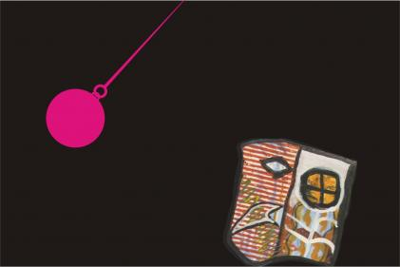

OBRIGADO!

